Slide 1

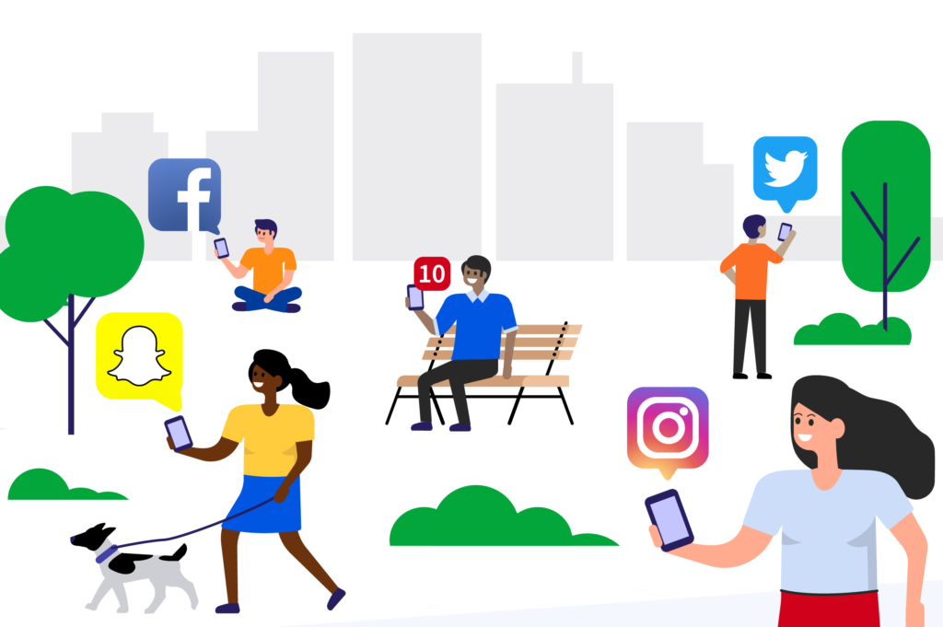
How does social media impact our lives?
Team members:
Anna Wrobel
Latyr Thiao
Lujane Abdelgadir
Prajakta Galvankar
Stephen Zhang

Slide 2

Thanks for your attention !
Table of contents
Motivations & Summary
Process summary
Data Cleanup & Exploration
Data Analysis
Questions & Findings
Conclusions & Limitations
Q & A

Slide 3
Motivation & Summary

Slide 4
Motivation & Summary
Main Question
Motivation
Social media is becoming increasingly important in our everyday lives
Key Questions to explore
Which social media platform/s do you like the most or use the most?
The number of users across all social media platforms is growing
We wanted to understand how much does it actually affect society
How much time is spent on social media vs physical activities?
Have you ever been a victim of cyber crime?
What type of communication is preferred?
Sources of Information
Data World Survey
https://data.world/maheepmahat/data-of-usage-of-social-media-by-students-between-age-17-22
How does social media impact our lives?

Slide 5
Data Cleanup & Exploration

Slide 6
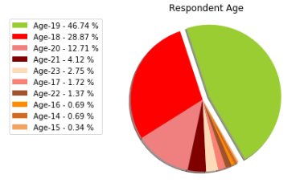
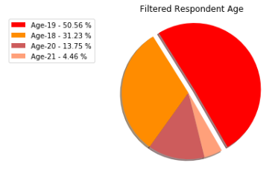
Data Cleanup & Exploration
Filtered the data to focus on responses of 18 to 21 year olds ( > 4% ) in order to have a more meaningful profile of respondents.

Slide 7
Data Cleanup & Exploration
We have applied a number of methods to clean up and organize the data.
Removed unnecessary columns in order to declutter the data and make it easier to read
Removed timestamp
Removed empty columns
Looked for and removed unavailable/empty responses
Cleaned responses and streamlined iterations into one value
One of the responses to types of cyber crime experienced was “Fake profile, none of the above”
Changed to “Fake profile”
Split the responses in order to count/tally the values
For the responses that allowed for multiple answers, we split the answers using “comma separator” and tallied the results, this was applied for answers to:
Preferred social media
Preferred form of communication
Types of cyber crime experienced

Slide 8
Data Analysis

Slide 9
Data Analysis
Analyzing the responses
Count / tally the responses for each question. (For example: which social media platform is preferred by the respondents?)
Visualizing the findings
Pie charts
Groupby responses in order to understand the dynamic relationships. (For example: relationship between platform preferences and time spent on social media)
Bar charts
Stacked bar chart
Line regression

Slide 10
Questions & Findings

Slide 11
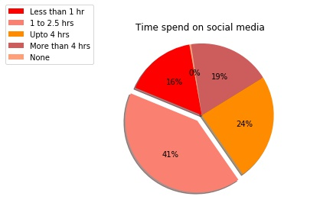
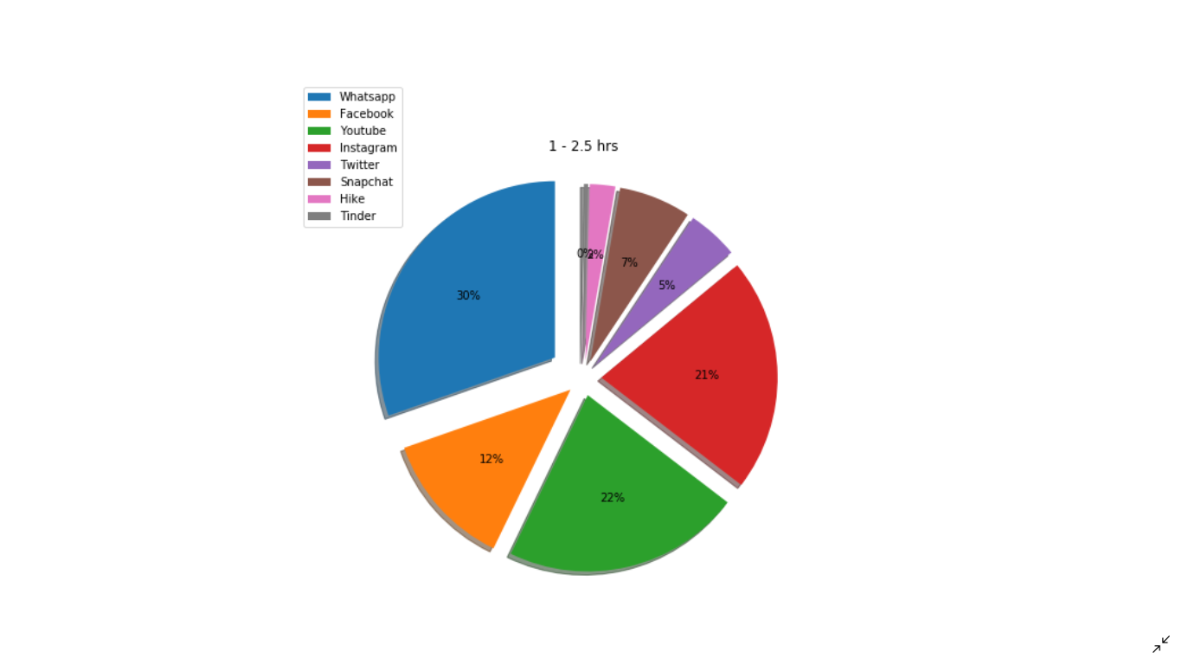
Which social media platform/s do you prefer? How often do you use social media?
WhatsApp, YouTube and Instagram are the most used social media platforms while 41% of respondents use social media for 1-2.5 hours per day.

Slide 12
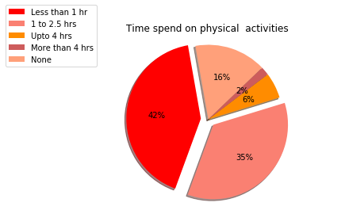
How much time is spent on social media vs physical activities?
Majority of respondents spend more time on social media compared to physical activities. 42% of respondents spend less than 1 hour per day on physical activities.

Slide 13
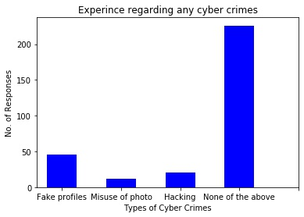
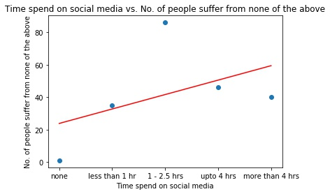
Have you ever been a victim of cyber crime?
Majority of respondents have not experienced the listed types of cyber crimes. The correlation between time spent online and exposure to cyber crime is insignificant due to large p value.
Linear equation of ‘No. of people suffer from other types of cyber crimes’ = 8.9*x_axis+23.8
p-value: 0.4315911476335936
r-square: 0.46361713132596477

Slide 14
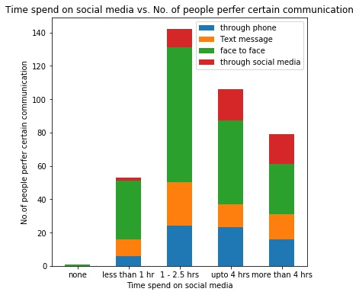
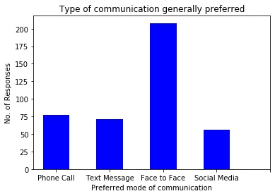
What type of communication is preferred?
Despite the increasing amount of time spent on social media, majority of respondents still prefer face to face communication.

Slide 15
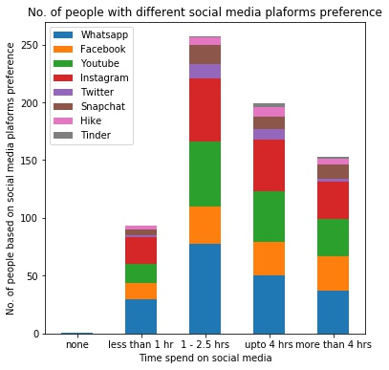
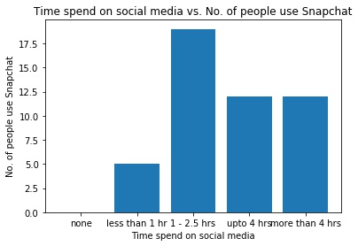
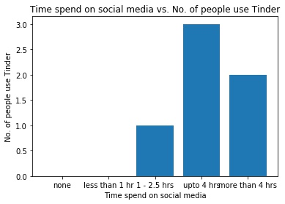
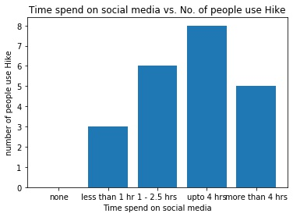
Is platform used impacted by time spent on social media?
Snapchat , Tinder and Hike as complementary social media platforms where people spend additional time on.

Slide 16
Conclusions & Limitations

Slide 17
Limitations & Further Research
Limitations
People tend to underestimate the time they spend online.
Further Research
Additional research considering APIs of various social media platforms.
The study did not cover exposure to scams, bullying, fake news etc.
Study across geographical regions & demographics to understand behavior of consumers in detail.
The study did not identify the geographical location of respondents.
The study did not include significant responses from other age groups.
Physical activity was vaguely defined in the survey.
Study considerable scope of cyber crimes experienced by respondents.

Slide 18
Conclusion
Conclusion
Whatsapp was noticed as most engaging social media platform and followed by Youtube & Instagram. Facebook was on 3rd position.
We observed impact of social media on our lives by comparing time spent on social media with physical activities, as a result respondent consume more time on social media than engaging into physical activities.
Based on the dataset, people are using social media as an additional form of communication, however it is not replacing the importance of face to face interaction.
Some of the respondents experienced the cyber crimes like hacking, misusing the photo, fake profile, while majority didn’t.

Slide 19
Thank you! Q & A

